Slide 1
Disproportionate Discipline: The Role of Implicit Bias Tia Elena Martinez The Center for Civil Rights Remedies at The Civil Rights Project at UCLA

Slide 2
Defining implicit bias
Implicit prejudices are social preferences that exist outside of conscious awareness.
Implicit attitudes, of which implicit prejudice is a special case, are understood to reflect associations between social categories (e.g., Black/White, old/young) and evaluations (e.g., good/bad, smart/dumb).
Implicit bias does not mean that people are hiding their racial prejudices. They literally do not know they have them.
In fact, the vast majority of those with implicit biases, hold no explicit biases.

Slide 3
How does it work? By relying on the same cognitive processes that make us efficient learners and ensure our survival when facing threats
We learn through patterned repetition. When two concepts become associated with one another in memory – we create automatic scripts in our brains such that the presentation of one of those concepts facilitates the recall or recognition of the other
These automatic scripts mean that the association and related recall operates super-efficiently without our awareness or intent
In the context of racial bias, people with a negative implicit racial bias toward Blacks will more quickly and easily respond to concepts associated with the negative stereotype of Blacks than concepts that are not associated with that stereotype
The brain’s threat detection center – the amygdala – the part of the brain that triggers the flight/fight response also plays a prominent role in implicit bias.
Sources: Phelps, O’Connor, Cunningham, Funayama, Gatenby, Gore, & Banaji, 2000; see also Stanley, Phelps, & Banaji, 2008
Notes:
Fear and the Brain
White individuals who score highly on measures of implicit racial bias also react to images of unfamiliar Black faces with stronger amygdala activation (Phelps, O’Connor, Cunningham, Funayama, Gatenby, Gore, & Banaji, 2000; see also Stanley, Phelps, & Banaji, 2008)

Slide 4
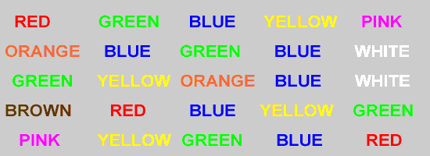
Ignore the word and simply name the color that the word appears.

Slide 5
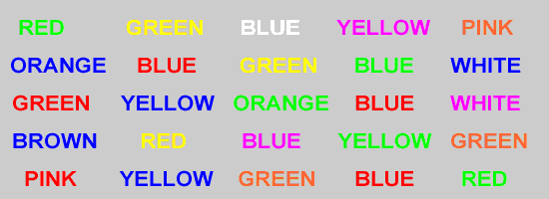
Ignore the word and simply name the color that the word appears.
.
Notes:
There are things you might try to ignore but try as you might just as the meaning of the word comes through disabling your ability to name something as simply the color of the object. So do things about social objects enter into our ideas about social groups even when we try to ignore it.

Slide 6
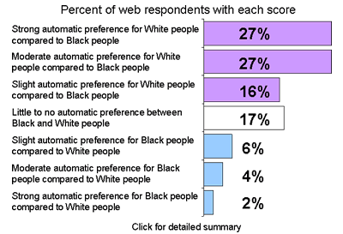
How is implicit bias measured? The implicit association test…
Harvard Implicit Association Test
https://implicit.harvard.edu
In the IAT, respondents are asked to categorize a sequence of images (as Black or White faces) and words (as either good or bad) by pressing one of two prelabeled buttons. Individuals who associate “Black” with “bad,” for example, will respond much more slowly when “Black” and “good” share the same response button
Built on the principal that it takes longer to say we recognize a weak mental association than a strong mental association
So if we are faster at recognizing associations between blacks and negative things, such as between blacks and crime, than at recognizing associations between blacks and positive things, such as between blacks and career success, then we have an implicit negative association towards blacks.
Notes:
A computer-based measure, the IAT requires that users rapidly categorize two target concepts with an attribute (e.g. the concepts "male" and "female" with the attribute "logical"), such that easier pairings (faster responses) are interpreted as more strongly associated in memory than more difficult pairings (slower responses).
Palpable experience of the greater ease of certain associations over others and the relative uncontrollability of the bad associations.

Slide 7
Does this type of bias really impact our behavior?
Physicians: Treatment Decisions
As pediatricians’ pro-White implicit biases increased, they were more likely to prescribe painkillers after surgery for vignette subjects who were White children as opposed to Black children
Police Officers: The Decision to Shoot
Police officers were more likely to mistakenly shoot unarmed Black suspects than unarmed White suspects in an computer simulation. Level of implicit bias predicted biased shooting behavior.
Hiring Managers: The Decision to Hire
Employment recruiters who favored native Swedes over Arabs on an implicit stereotyping task were signiﬁcantly less likely to offer Arab applicants job interview opportunities
Scores on an implicit stereotyping task involving race and intelligence were correlated with students’ likelihood of selecting resumes with African American names, especially among participants who felt rushed while completing a resume selection task
Source: Jost, Rudman, Blair, Carney, Dasgupta, Glaser & Hardin, 2009; Penner, Dovidio, West, Gaertner, Albrecht, Daily, & Markova, 2010; Berrtrand, Chugh, and Mullainathan, 2005. Eberhardt, Davies, Purdie-Vaughns, & Johnson, 2006)

Slide 8
What about in education? Race disparities are significantly larger when we look at suspensions for subjective, discretionary offenses
10.1
suspensions
Gap 7.7
Gap 2.9
4.5
suspensions
2.4
suspensions
1.6
suspensions
Source: Dan Losen and Tia Elena Martinez, 2013.

Slide 9
North Carolina example: Racial disparities in use of suspension for first time offenders by type of offense
Percent of first time offenders cited for committing the offense who received an out of school suspension as punishment
Source: Losen, 2012
Notes:
This means that those who were not suspended out of school the first time received another less severe punishment, such as in-school suspension, or no punishment at all.

Slide 10
Good news is implicit bias is quite malleable to context and environment; Four conditions that encourage implicit bias
Time constraints
Ambiguity
Cognitive overload / “busyness”
Lack of attention being paid to the task
Source: Dovidio & Gaertner, 2000; Johnson, Whitestone, Jackson, & Gatto, 1995; van Knippenberg, Dijksterhuis, & Vermeulen, 1999; Bodenhausen & Lichtenstein, 1987; Gilbert & Hixon, 1991; Sherman, Lee, Bessennof, & Frost, 1998
Notes:
Nosek, Hawkins, and Frazier (2011; in press) reviewed existing theories and evidence and suggested that implicit social cognition is more likely to predict behavior when the individual lacks (a) motivation to deliberately direct the behavior; (b) opportunity to initiate the relevant behavior; (c) ability to control the behavior; or (d) awareness of factors that influence the behavior (e.g., Fazio, 1990; Gawronski & Bodenhausen, 2006; Perugini, Richetin, & Zogmaister, 2010).
The context of interracial interaction illustrates these factors. People may possess motivation, opportunity, ability, and awareness to control what they say in an interaction with a person from another racial group, but they may lack motivation, opportunity, ability, or awareness to control their non-verbal behavior in that interaction.
Providing objective criteria to guide decision-making, such as listing job requirements immediately prior to selecting a candidate can constrain
opportunities to use subjective criteria in candidate selection (Uhlmann & Cohen, 2005).
Impact of motivation and mindsets: Further, providing insight that one’s behavior could be influenced by implicit biases can instigate efforts
to control the expression of such biases without affecting the biases themselves (Bartlett, 2009;Monteith, Ashburn-Nardo, Voils, & Czopp, 2002; Monteith & Mark, 2005).
Ironically, changing mindsets can sometimes increase discrimination. For instance, instructing people to assert that they are objective decision-makers prior to a hiring decision increases gender (Uhlmann & Cohen, 2007) and age discrimination (Lindner, Nosek, & Graser, 2012). This emphasizes the delicacy of inducing mindsets to alter behavior. Whereas the motivation to be non-prejudiced may lead to reduced discrimination (Bartlett, 2009; Plant, Devine, & Peruche, 2010), thinking of oneself as non-prejudiced may ironically increase discrimination (Monin & Miller, 2001).

Slide 11
Can we do anything to reduce implicit bias and related behaviors?
What Worked
Reducing the contextual factors that encourage implicit bias: Reduce sources of stress (including time constraints) in the decision-making environment and identify sources of ambiguity and impose greater structure in the decision making context
Flip the script: Provided experience with counter-stereotypical exemplars, people thought about famous Black people and infamous White people
Increase intergroup contact with stereotyped group: Whites assigned to live with a Black roommate exhibited less implicit prejudice than Whites assigned to live with a White roommate; Even just having a black researcher administer the test decreased levels of implicit bias.
Intrinsic motivation: Strong intrinsic motivation to reduce prejudice is effective in decreasing implicit bias and in decreasing behavioral expressions of this bias. Study participants in whom autonomous motivation to regulate prejudice was induced displayed less explicit and implicit prejudice compared with no-treatment control participants.
Semester long seminar: a seminar on prejudice and intergroup conflict was associated with reduced implicit prejudice at the end of a semester
Source: Lai, Calvin K. and Hoffman, Kelly M. and Nosek, Brian A., Reducing Implicit Prejudice (May 29, 2013). Social and Personality Psychology Compass, 7, 315-330, 2013.; Legault et. al, 2011; Fazio, 1990; Gawronski & Bodenhausen, 2006; Perugini, Richetin, & Zogmaister, 2010; Bartlett, 2009; Monteith, Ashburn-Nardo, Voils, & Czopp, 2002; Monteith & Mark, 2005; Uhlmann & Cohen, 2007; Lindner, Nosek, & Graser, 2012
Notes:
In two experiments, participants received detailed information on, or were primed with, the goal of prejudice reduction; the information and primes either encouraged autonomous motivation to regulate prejudice or emphasized the societal requirement to control prejudice. Ironically, motivating people to reduce prejudice by emphasizing external control produced more explicit and implicit prejudice than did not intervening at all. Conversely,
Legault, L., Gutsell, J.N., & Inzlicht, M. (2011). Ironic effects of anti-prejudice messages: How motivational interventions can reduce (but also increase) prejudice. Psychological Science, 22 (12), 1472 – 1477.
By defining individuals in multiple ways other than in terms of race, implicit bias may be reduced (e.g., Djikic, Langer, & Stapleton, 2008; Lebrecht, Pierce, Tarr, & Tanaka, 2009; Corcoran, Hundhammer, & Mussweiler, 2009).

Slide 12
Can we do anything to reduce implicit bias and related behaviors?
What Did Not Work
Color blind approach: Students exposed to a color blind approach actually increased their implicit and explicit bias compared to those exposed to a multicultural approach. Instructing people to assert that they are objective decision-makers prior to a hiring decision actually increased gender and age discrimination
Extrinsic Motivation and Positive Feedback: Inducing extrinsic motivations to regulate prejudice or giving feedback suggesting that one is progressing on egalitarian goals can lead to greater implicit racial prejudice. Whereas the motivation to be non-prejudiced may lead to reduced discrimination thinking of oneself as non-prejudiced may ironically increase discrimination.
Source: Lai, Calvin K. and Hoffman, Kelly M. and Nosek, Brian A., Reducing Implicit Prejudice (May 29, 2013). Social and Personality Psychology Compass, 7, 315-330, 2013; Apfelbaum, Sommers, & Norton, 2008; Macrae, Bodenhausen, Milne, & Jetten, 1994 Fazio, 1990; Gawronski & Bodenhausen, 2006; Perugini, Richetin, & Zogmaister, 2010; Bartlett, 2009; Monteith, Ashburn-Nardo, Voils, & Czopp, 2002; Monteith & Mark, 2005; Uhlmann & Cohen, 2007; Lindner, Nosek, & Graser, 2012
Notes:
Table 1. Motivational Primes Used in Experiment 2
Autonomy-prime condition:
I enjoy relating to people of different groups.
Being nonprejudiced is important to me.
I can freely decide to be a nonprejudiced person.
I value diversity.
It’s fun to meet people from other cultures.
It’s not important to understand others. (reverse-scored)
Equality and equal rights across cultural groups are important
values.
I think that issues of diversity are interesting.
Controlling-prime condition:
It is socially unacceptable to discriminate based on cultural
background.
People should be unprejudiced.
I would be ashamed of myself if I discriminated against someone
because they were Black.
There are no social norms about prejudice in society.
(reverse-scored)
I should avoid being a racist.
I would feel guilty if I were prejudiced.
Prejudiced people are not well liked.
People in my social circle disapprove of prejudice.
By defining individuals in multiple ways other than in terms of race, implicit bias may be reduced (e.g., Djikic, Langer, & Stapleton, 2008; Lebrecht, Pierce, Tarr, & Tanaka, 2009; Corcoran, Hundhammer, & Mussweiler, 2009).

Slide 13
Only two interventions managed to change implicit bias over the long term and both were about relationships
White and Asian American participants showed less implicit prejudice against Latinos after they got to know a Latina peer with whom they had a common interest, such as the same favorite book, and after they worked with her on a group activity that incorporated elements of Mexican culture
Surprisingly, the effects of the brief laboratory interaction lasted over time. Participants not only expressed greater interest in interacting with Mexican Americans, but also had somewhat more positive attitudes toward undocumented Mexican immigrants in an unrelated survey six months later
Didn’t work if the project was not focused on a non-Mexican cultural group and didn’t work if they felt the topic had not been freely chosen
Source: Brannon and Walton, Association for Psychological Science Press Release, August 23, 2013.
Notes:
Participants showed no reduction in prejudice when they worked with the Latina peer on a project related to a non-Mexican cultural group, suggesting the importance of engaging in the peer’s culture.
Participants only showed reduced prejudice when they felt they had freely chosen the topic of the group activity.

Slide 14
Relationship dynamics matter…
The dynamic behind disparate rates of suspension is a highly recursive, interactive processes between students of color and teachers over time involving:
social context
Minority students’ worries about being
seen and treated stereotypically, about belonging
Teachers’ implicit racial biases, judgments about and treatment of students of color
G. Walton, J. Eberhardt, J Okonofua, 2013

Slide 15
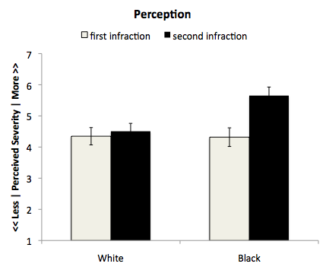
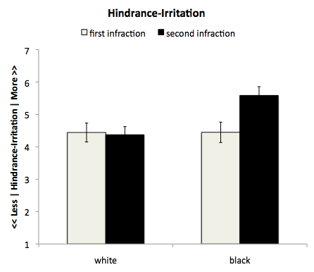
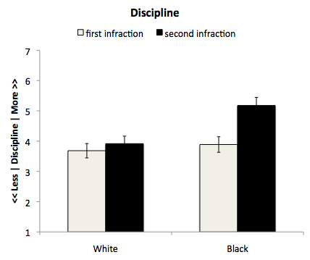
Impact of student race on teacher perception of misbehavior and escalation of punishment
Significant difference between how teachers perceived black and white students for the SECOND incident of misbehavior…
Study of teachers perception of and response to minor incidents of student misbehavior; examples include sleeping in class, wandering around classroom, talking to friends
Demonstrated that repeated infractions produced by a Black student are more likely to lead to teacher irritation and to a concern that the student will hinder their ability to teach which, in turn, leads to harsher disciplinary responses.
No difference between how teachers perceived black and white students for their first incident of misbehavior…
Source: Okonofua and Eberhardt, Two-Strikes: Race and Disciplinary Action in K-12 Schooling, In Press.
Notes:
Hypothesize that racial stereotypes associated with Black students make it more likely that teachers will view infractions over time as a problematic pattern. Teachers were also significantly more likely to label the black students as “trouble makers” than white students with similar misbehavior
The first infraction informs how the second infraction should be read—heightening negative emotions and escalating harsh disciplinary treatment.
Conclude that the primary function of the stereotyping process more generally may be to heighten perceivers’ sensitivity to potential behavioral patterns across time.

