Slide 1
Social & Emotional Learning Multi-Tiered Systems of Support
David Osher
American Institutes for Research
James Comer
Yale University

Slide 2
Multi-Tiered Systems of Support
Intervene Early & Provide Focused Youth Development Activities
Implement strategies and provide supports that address risk factors and build protective factors for students at risk for severe academic or behavioral difficulties.
Provide Individualized Intensive Supports
Provide coordinated, intensive, sustained, culturally competent, individualized, child- and family- driven and focused services and supports that address needs while building assets.
Build a Schoolwide Foundation
Universal promotion & prevention ( caring school climate, positive and proactive\restorative approach to discipline, personalized instruction, cultural competence, strong family engagement & organizational efficacy )

Slide 3
What Affects Learning and Behavioral Outcomes?
Enhanced Capacity to Realize Better Outcomes
Teaching | Learning
Competencies
Conditions

Slide 4
Conditions For Learning & Self-Discipline
Safety
Physically safe
Emotionally safe
Low Risk Environments
Support , Care, & Connection
Meaningful connection to adults
Experience of Care & Respect
Strong bonds to school family &
other community institutions
Positive peer relationships
Effective and available support
Challenge & Engagement
High expectations
Educational opportunities are
connected to life goals
Strong personal motivation
Engagement
Robust opportunities to learn
Peer and Adult Social Emotional Competency
Understand & Manage Emotions
Understand & Relationships
Pro-social Values and Dispositions
(Attitudes/Mindsets)
Good decision making
Osher et al., 2008

Slide 5
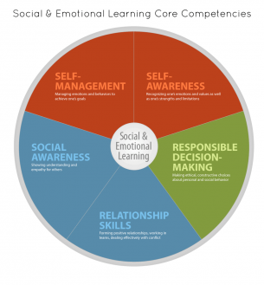
Social and Emotional Competence
http://casel.org

Slide 6
Supporting Conditions for Learning
Connection
Attachment
Trust
Care
Respect
Inclusion
Social Emotional
Learning & Support
Positive & Strengths Based
Social, Emotional
& Behavioral Supports
Academic Support
Effective Pedagogy
Engagement
Motivation

